Slide 1
Data Visualization Project On E-Commerce Company

Slide 2
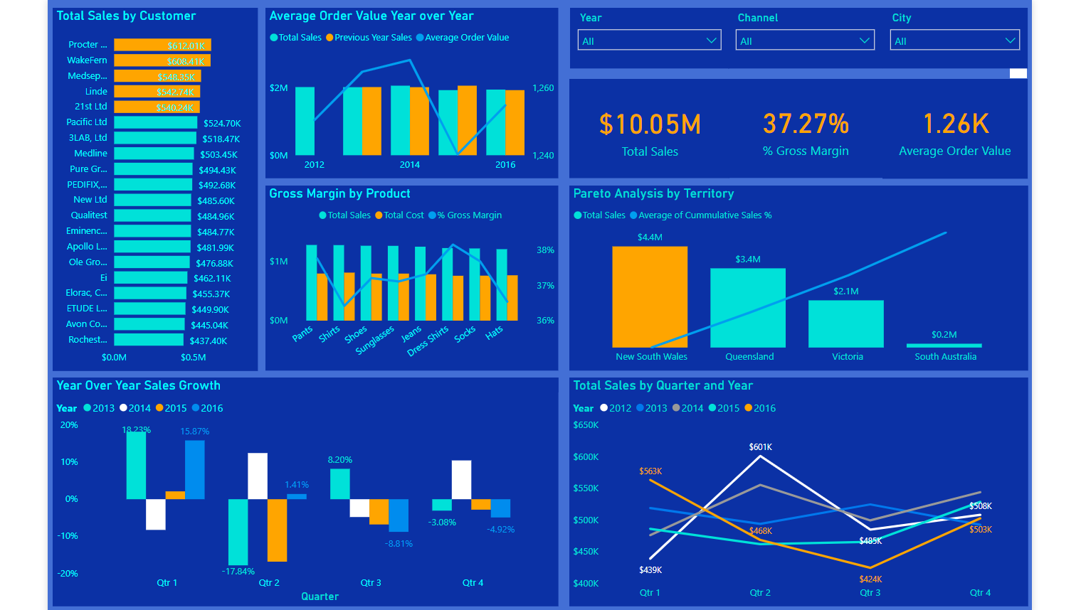
Project Background
The purpose of this project is to develop a Sales report which looks at high level performance metrics of a fictional E-Commerce business from the year 2012 to 2017. Some data Pre-processing was done before analysis on Power Bi.
Below is a snapshot of the Sales Dashboard for our fictional E-Commerce company.

Slide 3
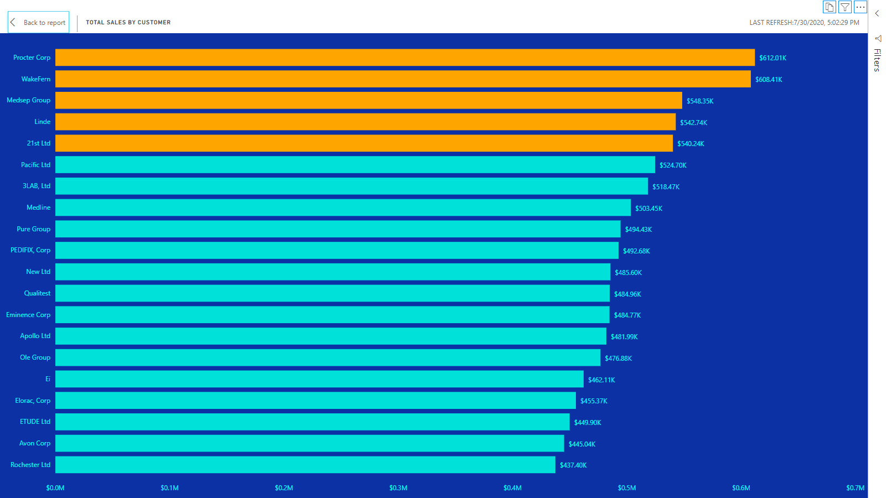
Total Sales by Customer
A sales team has a single job and that is to make money. This visualization highlights the customers that contribute majorly to that. It shows the business’s top performing customers by sales within the period.
We can see that the top 5 performing customers, which are highlighted in orange are, Procter Corp, WakeFern, Medsep Group, Linde and 21st Ltd.

Slide 4
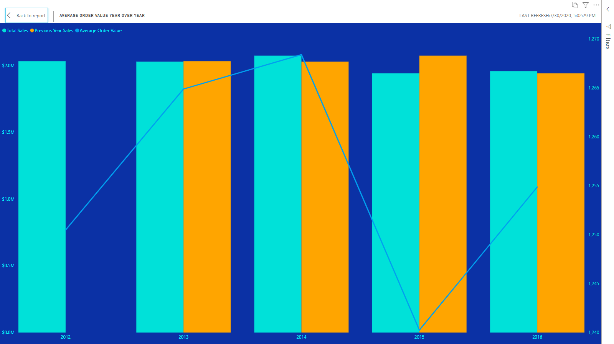
Average Order Value Year – Over – Year
This metric which is sometimes referred to as Average Purchase Value is a simple measure of the average amount spent on each order. This is an important metric because it helps top management understand what kind of orders the sales team are closing. If the average order value (AOV) is lower than benchmarked values, it suggests that the company’s sales reps are probably chasing low-hanging fruits or discounting too aggressively.
What this implies is that AOV needs to be as high as possible. A way of raising this is by selling higher value products through upselling or selling more products together through cross-selling.
This metric was measured on a year by year basis with a comparison being made with the previous year’s sales figures.

Slide 5
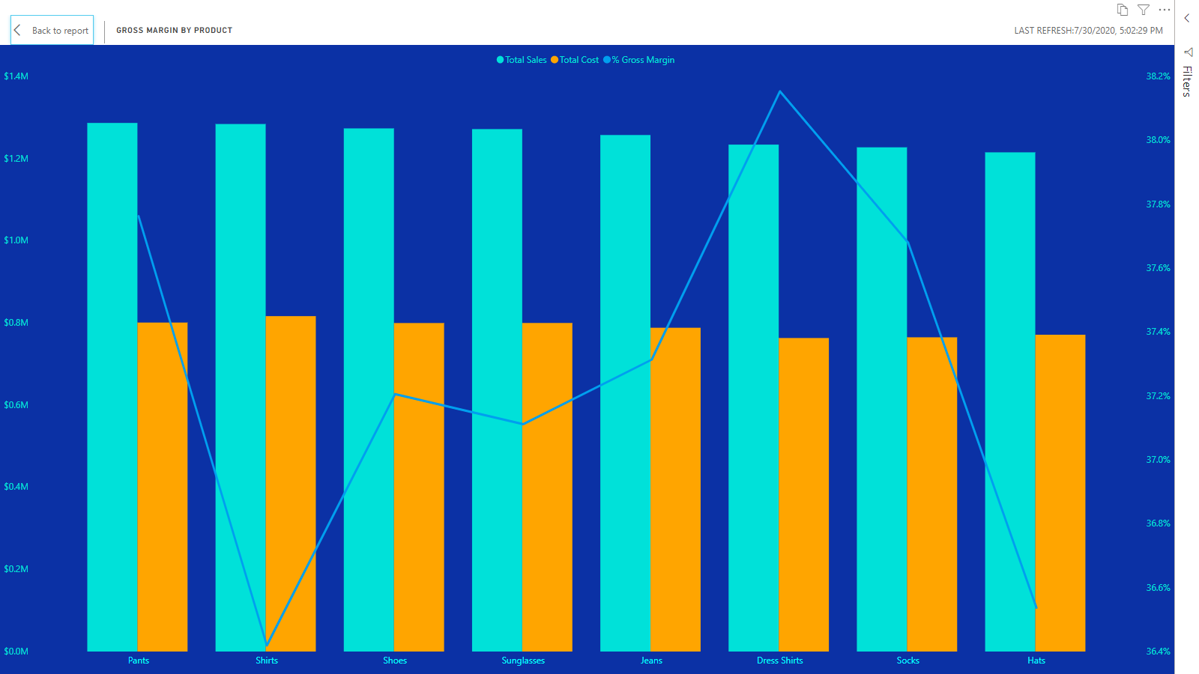
Gross Margin by Product
The gross margin by product visualization assesses the company’s financial health on a product by product basis. The gross margin which is derived by calculating the amount of money left over from product sales after subtracting the Cost of Goods Sold measures how profitable the company’s products are. This is an important metric for executive management because it is an indication of how efficient the company uses its resources. If costs are high, then gross margin will be low.
The key insight from this visualization is that even though the product with the most sales is ‘Pants’, it is not the most profitable product. This is because the cost of selling the pants is also high. From the chart, we can see that ‘Dress Shirts’ is the most valuable product for the company as it has the highest gross margin percentage

Slide 6
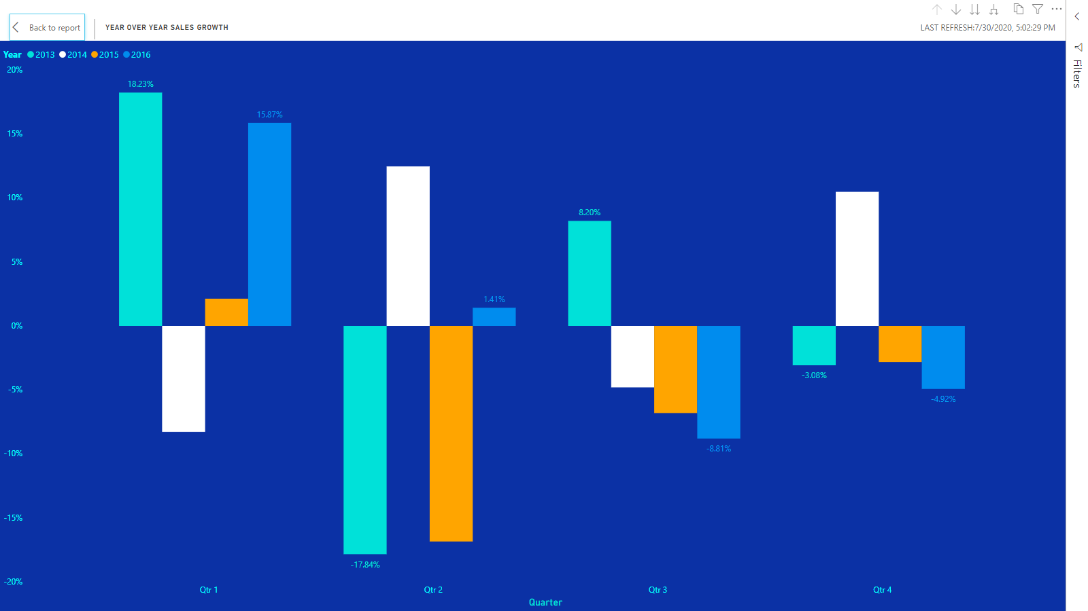
Year – Over – Year Sales Growth
Year – over – year (YOY) is the comparison of one period with the same period from the previous year. This visualization looks at the company’s change in sales YOY on a quarterly basis. This is an effective way of looking at growth because it removes the effects of seasons from the analysis as you can compare current years quarterly performance with that of previous years.
By measuring sales growth, executive management can know if the company’s current sales and marketing strategies are working. It also allows them to conclude on whether the company is growing or not.
In our fictional company, we can say that the company has remained stagnant over the 5-year period in question.

Slide 7
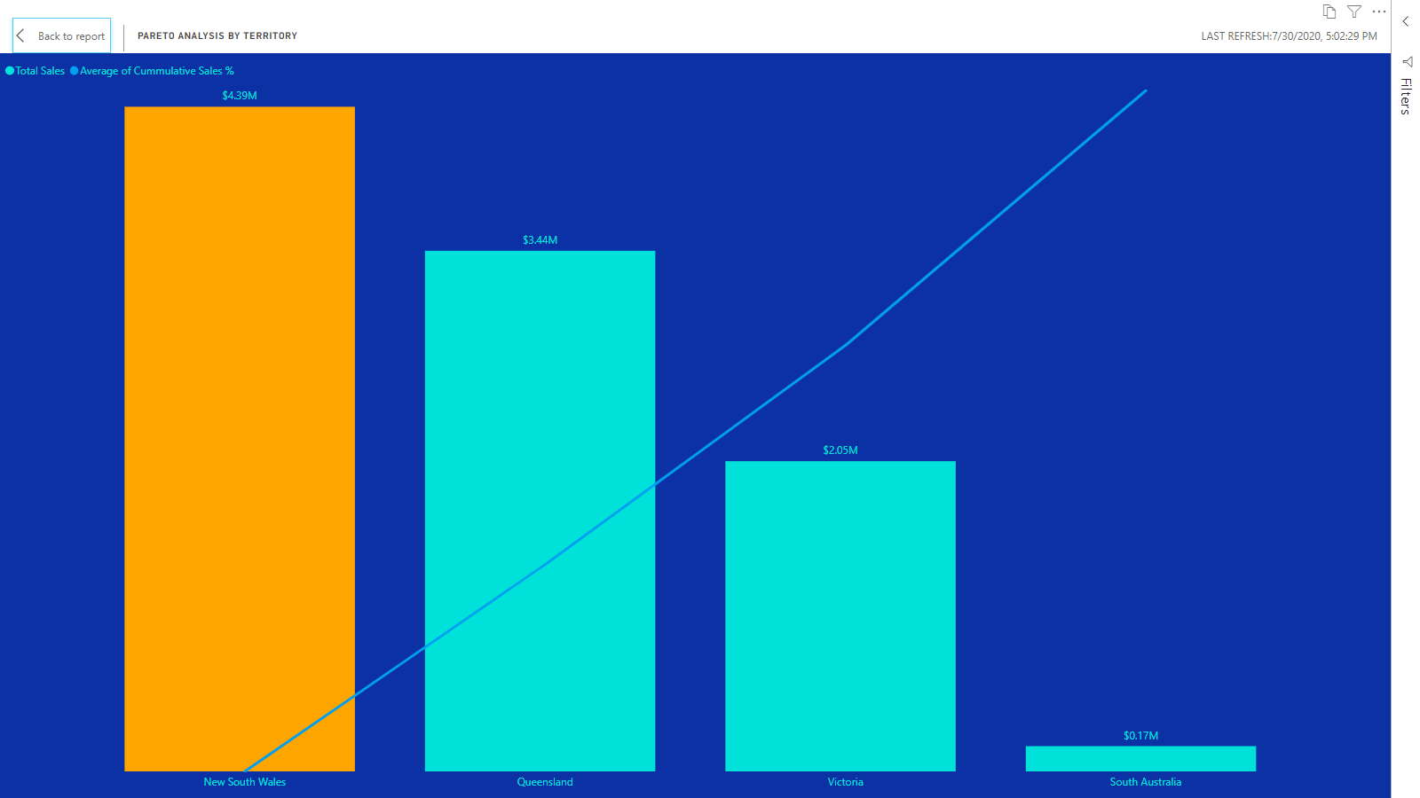
Pareto Analysis by Territory
The pareto principle which is also called the 80/20 rule suggests that 20 percent of your activities will account for 80 percent of your results. The pareto principle was applied in this visualization to find out which territory contributed the most to the company’s sales within the 5-year period.
We can see that New South Wales which counts as 25% of the company’s operational territory accounted for 74.59% of the company’s sales within the 5-year period. What this means for the company is that the customers who fall within the New South Wales Territory are highly valuable to the company and as such the company should focus more acutely on these valuable customers. This can be done by focusing marketing campaigns on this region or by targeting new customers with similar characteristics to those of customers within this region.

